Slide 1
LAFCO 101
Introduction to
Kern Local Agency Formation Commissions
Blair Knox
Executive Officer
Kern LAFCO
April 17, 2024
1

Slide 2
What’s Ahead
Why LAFCO was Created
LAFCO’s Legislative Mission, Scope and Composition
LAFCO’s Planning and Regulatory Functions
LAFCO’s Legal Foundation
Commission Roles and Challenges
Q & A
2

Slide 3
Why LAFCO was Created
Post World War II population and housing boom in California
From street cars to suburbs - a scramble to finance and extend services
City annexation "wars," and a proliferation of limited purpose special districts
Governor Pat Brown’s Commission on Metropolitan Problems focused on need to encourage orderly boundaries
3

Slide 4
LAFCO’s Purposes
Encourage orderly boundaries
Discourage urban sprawl
Preserve agriculture and open space
Promote efficient public services
Consider regional housing needs, adequate water and other issues
4

Slide 5
Legislative Compromise
No Statewide Commission
A LAFCO in each county
Local control; no State appointees
LAFCOs are independent; no administrative appeal
5

Slide 6
Legislative History
1963 - Knox-Nisbet Act – LAFCOs created to regulate boundaries
1965 - District Reorganization Act to unify district procedures
1971 - Spheres of Influence – LAFCOs plan, too
1972 - Allow special district members
6

Slide 7
Legislative History
(cont’d)
1977 - Municipal Organization Act – Clean up city procedures
1983 - Deadline to prepare Spheres of Influence
1985 - Cortese-Knox- Local Government Reorganization Act - Recodified
1993 - AB 1335 (Gotch) – Improved procedures, extraterritorial review
7

Slide 8
Cortese-Knox-Hertzberg Local Government Reorganization Act of 2000
Major Reforms:
Broaden LAFCO funding formula
Make LAFCO the conducting authority
Require Municipal Service Reviews and periodic Sphere of Influence updates
Add new factors – water supply, regional housing
10

Slide 9
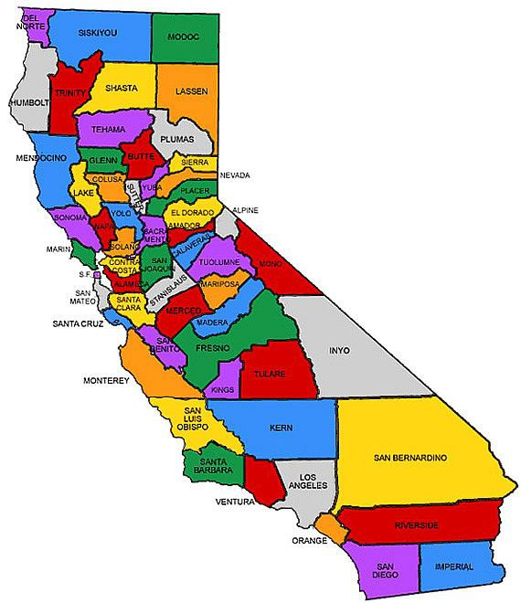
LAFCO
in Every County

Slide 10
LAFCO Composition
At the least:
2 County Supervisors
2 City Council members
1 Public member
Alternate for each category
30 LAFCOs also include 2 Special District members plus an alternate.
Some LAFCOs have “special seats.”

Slide 11
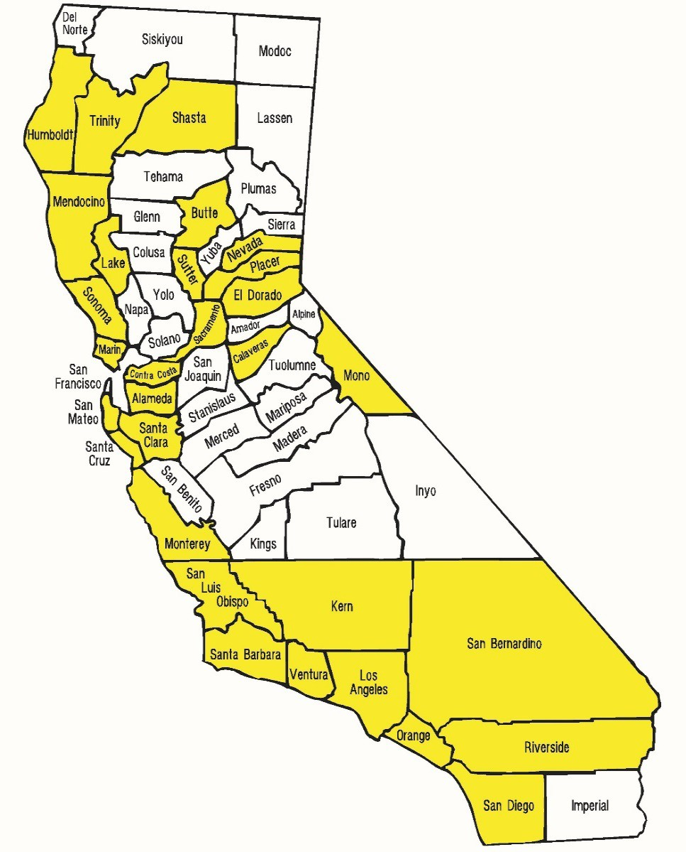
Commissions a Unique Mix
30 LAFCOs
with Special District Members

Slide 12
Local Agencies Regulated by LAFCO
Include:
  Counties, cities, most special districts
Do NOT include:
  JPAs
  Community facilities or Mello-Roos districts
  School or college districts
  County boundaries
  Bridge and highway districts* (GBSGD)
  Improvement districts
  Zones of benefit
  Air pollution/quality districts

Slide 13
What Can LAFCO Do?
Annexations
Detachments
City Incorporations (and Disincorporations)
District Formations (and Dissolutions)
Consolidations and Mergers
Service Extensions outside a District or City
Spheres of Influence
Municipal Service Reviews
Activate Latent Powers
Review Fire Contracts

Slide 14
LAFCO’s Planning Functions
Develop and update Spheres of Influence for cities and districts
Coordinate Municipal Service Reviews (MSR) with local jurisdictions
Work cooperatively on growth, preservation and service delivery issues

Slide 15
LAFCO’s Regulatory Functions
Administer modifications of existing agencies and creation of new ones
Consider boundary changes
Control extension of public services
Prohibited from directly regulating land use

Slide 16
Subject to State Laws
Cortese-Knox-Hertzberg Act
Brown Act / Public Records Act
CEQA
Revenue & Tax Code
Political Reform Act / Other Conflict of Interest Laws
Principal Acts

Slide 17
Limited Legal Challenge
LAFCO decisions are quasi-legislative
Not appealable to any other body except the courts
Short period to file suit
Limited legal challenge to decisions
Upheld as long as decision is not “arbitrary and capricious”

Slide 18
LAFCOs’ Key Legal Concerns
Must act in accordance with state law and locally adopted policies
Comply w/ CEQA as lead or responsible agency
Must adopt findings to support decision (McBail)

Slide 19
LAFCO Process
Pre-Application Steps
Meet with LAFCO staff
City-County consultation (for Sphere of Influence amendments)
Prepare an application package
Initiating petition or resolution

Slide 20
LAFCO Process
(cont’d)
Public Hearing Steps
LAFCO receives application package
Referrals to Surveyor, Assessor, Elections and CAO for tax exchange and comment to affected agencies
Review for completeness
Consistency analysis
Staff report with recommendations
Conduct public hearing

Slide 21
LAFCO Process
(cont’d)
Post-Hearing Steps
If Commission approves application, then:
Reconsideration period, if required
Conduct Protest hearing, if required
Satisfy any conditions of approval
File documents with County Recorder and State Board of Equalization, if required

Slide 22
LAFCO Misperceptions
LAFCO has a “magic wand” that instantly solves boundary and service issues.
LAFCO proceedings do not require deliberate review and analysis that require agency and public collaboration and/or support.
LAFCO is an arm of the county, not the state.
LAFCO’s sole mission is to approve agencies, particularly special districts.
LAFCO’s role is always “reactive” and not “proactive.”
30

Slide 23
Litigation
What Claims are Most Common?
  CEQA
  Cortese Knox Hertzberg Act
  Civil Rights Claims
  Public Records Act
  Brown Act
  Political Reform Act and Other Conflict Laws
23

Slide 24
Litigation
Most common claims seek a writ of mandate
Such cases are reviewed on your administrative record
The standard of review is more deferential under CKH and CEQA than on civil rights claims or the Political Reform Act or Brown Act
24

Slide 25
Avoiding Litigation
Thus, preventing litigation can be summarized as
  Avoid procedural error
  Ensure there is substantial evidence to support every required finding
Common procedural errors
  Notice
  Making all the findings and tying findings to evidence
  Allowing a fair hearing, avoiding bias and conflicts of interest
25

Slide 26
LAFCOs are Independent
“Where you stand depends on where you sit.”
All commissioners take off their county, city, or special district hats and serve all of Kern County as members of LAFCO
26

Slide 27
LAFCOs are Independent
Commissioners make final decisions
Adopt local policies
Decisions cannot be appealed to other administrative bodies
LAFCO staff accountable to Commission and statutes
27

Slide 28
Commissioners are Independent, too
Exercise independent judgment on behalf of public, not appointing agency
Based on CKH and local LAFCO policies - not solely on interests of appointing agency
“LAFCO Hat” involves a broader perspective representing “public as a whole”
28

Slide 29
Commissioners’ Role
What decisions will you make?
What are your responsibilities?
Active agenda vs. reactive caseload
Make decisions that are supported by statute, local policies, and sound and comprehensive staff analysis
29

Slide 30
Each Commission is Independent
Provides own office, equipment, personnel
Appoints an Executive Officer
Appoints a Legal Counsel
Can contract for staff services
30

Slide 31
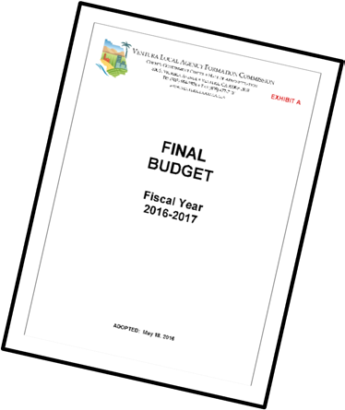
LAFCO is Funded Locally
Must adopt a work program and budget for each fiscal year by June 15
Budget process is outlined in CKH Act
Funded by the county, cities, and special districts (usually in equal shares)
County Auditor processes the invoices
40

Slide 32
LAFCO is Funded Locally
(cont’d)
Local funding formulas are allowed
Processing fees help to offset expenses for proposals
Adoption of fee schedule recommended

Slide 33
LAFCO Staff Serve the Public and Commission
Provide accurate and comprehensive information
Analyze and interpret CKH and other laws (CEQA, general plans, etc.)
Process proposals consistently w/ CKH and local procedures and policies
Prepare notices, staff reports, studies and recommendations
Implement Commission decisions

Slide 34
Commissioner/Staff Engagement
Seek out staff for additional information or questions before LAFCO meetings
Use related professional background and experience to assist staff
Make yourself available to staff – communication is a mutual exchange

Slide 35
Current Challenges
Sphere of Influence updates and Municipal Service Reviews (56425(g))
Disadvantaged Unincorporated Communities (56375(a)(8))
Viability of smaller local agencies
Water, water, water (SGMA implementation, etc.)

Slide 36
Discussion
Questions and Answers
36

Slide 37
Blair Knox, Executive Officer
5300 Lennox Ave. Suite 303
Bakersfield, CA 93309
661-716-1076
info@kernlafco.org
www.kernlafco.org
37

